Slide 1
Microsoft Commercial Marketplace
Microsoft Skilling

Slide 2

Learning objectives
In this workshop, you will participate in lecture and group activities to accomplish the following items:
Accessing and navigating the Microsoft Marketplace.
Searching and deploying solutions in the Microsoft Marketplace.
Integration of procurement applications into the Microsoft Marketplace.
Microsoft Marketplace governance and permissions.
Managing purchases and setting up limits.
Notes:
Review the learning objects with the participants.

Slide 3
What to expect
This workshop includes:
This workshop does not include:
Content with documented use cases and discussion topics
Documented exercises to follow along with the instructor
Hands-on lab experience
Shared hands-on lab environment (aka OpenHack)
Lecture without interaction

Slide 4
Day Two: Marketplace procurement application integration and governance

Slide 5

Day One
9:00 | 20 minutes | Kick-off and overview
9:30 | 60 minutes | What is Microsoft Marketplace
10:30 | 90 minutes | Purchasing in Marketplace
12:00 | 45 minutes | Lunch
12:45 | 165 minutes | Labs – Deployment of resources and SaaS offerings through the Marketplace
15:00 | 20 minutes | Wrap-up – General Channel
Agenda
Day Two
9:00 | 30 minutes | Day One review and questions
9:30 | 60 minutes | Integrating Marketplace with Procurement Systems
10:30 | 60 minutes | Private offers overview
12:00 | 45 minutes | Lunch
12:45 | 60 minutes | Private Marketplace overview
13:45 | 105 minutes | Lab - Setting up and using a private Marketplace
15:00 | 20 minutes | Wrap-up
Notes:
NOTE: Your start time may vary. Please fill in time zone for this delivery.
SAY:
Training is x hours long.
There are no scheduled breaks, take when needed. There is a 45-minute lunch.
Head Coach will start the workshop in the General Channel and wrap up the workshop at the end of the day in the General Channel.
The rest of the day, the students will work in their individual TEAM Channels with you as the other coaches leading them through activities and monitoring the schedule.
Coach should do a high-level walk-through of the agenda and what is happening at each of the lab modules.

Slide 6
Day Two
9:00 | 30 minutes | Day One review and questions
9:30 | 60 minutes | Integrating Marketplace with Procurement Systems
10:30 | 20 minutes | Break
10:50 | 70 minutes | Private offers overview
12:00 | 45 minutes | Lunch
12:45 | 60 minutes | Private Marketplace overview
13:45 | 20 minutes | Break
14:05 | 105 minutes | Lab - Setting up and using a private Marketplace
15:50 | 20 minutes | Wrap-up
Agenda
Notes:
NOTE: Your start time may vary. Please fill in time zone for this delivery.
SAY:
Training is x hours long.
There are no scheduled breaks, take when needed. There is a 45-minute lunch.
Head Coach will start the workshop in the General Channel and wrap up the workshop at the end of the day in the General Channel.
The rest of the day, the students will work in their individual TEAM Channels with you as the other coaches leading them through activities and monitoring the schedule.
Coach should do a high-level walk-through of the agenda and what is happening at each of the lab modules.

Slide 7
Introduction
In this module, you’ll begin by learning how to connect procurement applications to Marketplace. You will also create a private Marketplace and setup purchasing permissions.
After completing this module, you’ll be able to:
Integrate Marketplace with Procurement Systems.
Integration of Entra ID to Procurement Systems.
Setting up a private Marketplace.
Create purchasing permissions and resource purchase limits.

Slide 8
Procurement and Azure Marketplace
What you need to know:
Billing accounts and subscriptions
Must be subscription owner or contributor to purchase
Azure subscriptions is consumption-based
SaaS subscription is time-based
Billing account ID is needed for private offer agreements

Slide 9
Account Settings
Two steps for purchase private offers:
Accept
Purchase
SaaS subscriptions
Completed in publisher's portal
Requires Entra ID (Azure Active Directory) permissions
Finding permissions
Marketplace private offers precheck tool (https://learn.microsoft.com/en-us/marketplace/private-offers-pre-check)
Private marketplace – product will be in the allow list
Azure policies – used to block or enforce tagging when resources are created

Slide 10
Account settings demo
In Azure portal, go to: Subscriptions > select the subscription > resource providers > filter by the word “marketplace” > make sure all three results are enabled for Azure Marketplace.
To find your billing account permissions, go to the Azure portal and select Cost Management & Billing > Billing Scopes > (select the billing account you want) > Access Management (IAM).
If you don't see the billing account you're looking for, it means you don't have permission to it (including read-only permissions). To learn more, see Billing accounts and scopes in the Azure portal.
To find if you can register third-party applications via SSO, check on Azure AD menu that users can register applications (Activating your SaaS service requires SSO permissions to third party apps)
Notes:
Configure how users consent to applications - Microsoft Entra | Microsoft Learn
Procurement playbook - How to drive custom deals on Azure Marketplace - Microsoft marketplace | Microsoft Learn

Slide 11
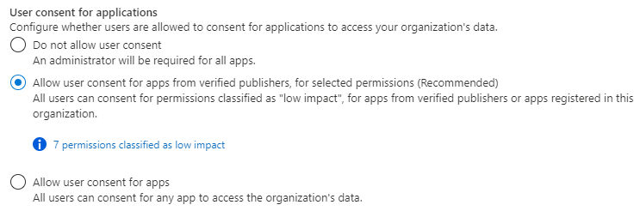
User Consent to Applications
Users need to grant permission for apps to access data
Settings can allow or deny users from granting these permissions
Configure user consent settings within Entra admin center
Prerequisites:
User account
Global Administrator role for configuration
To configure user consent settings through the Microsoft Entra admin center:
Sign in to the Microsoft Entra admin center as as a Global Administrator.
Browse to Identity > Applications > Enterprise applications > Consent and permissions > User consent settings.
Under User consent for applications, select which consent setting you want to configure for all users.
Select Save to save your settings.
Notes:
Configure how users consent to applications - Microsoft Entra | Microsoft Learn

Slide 12
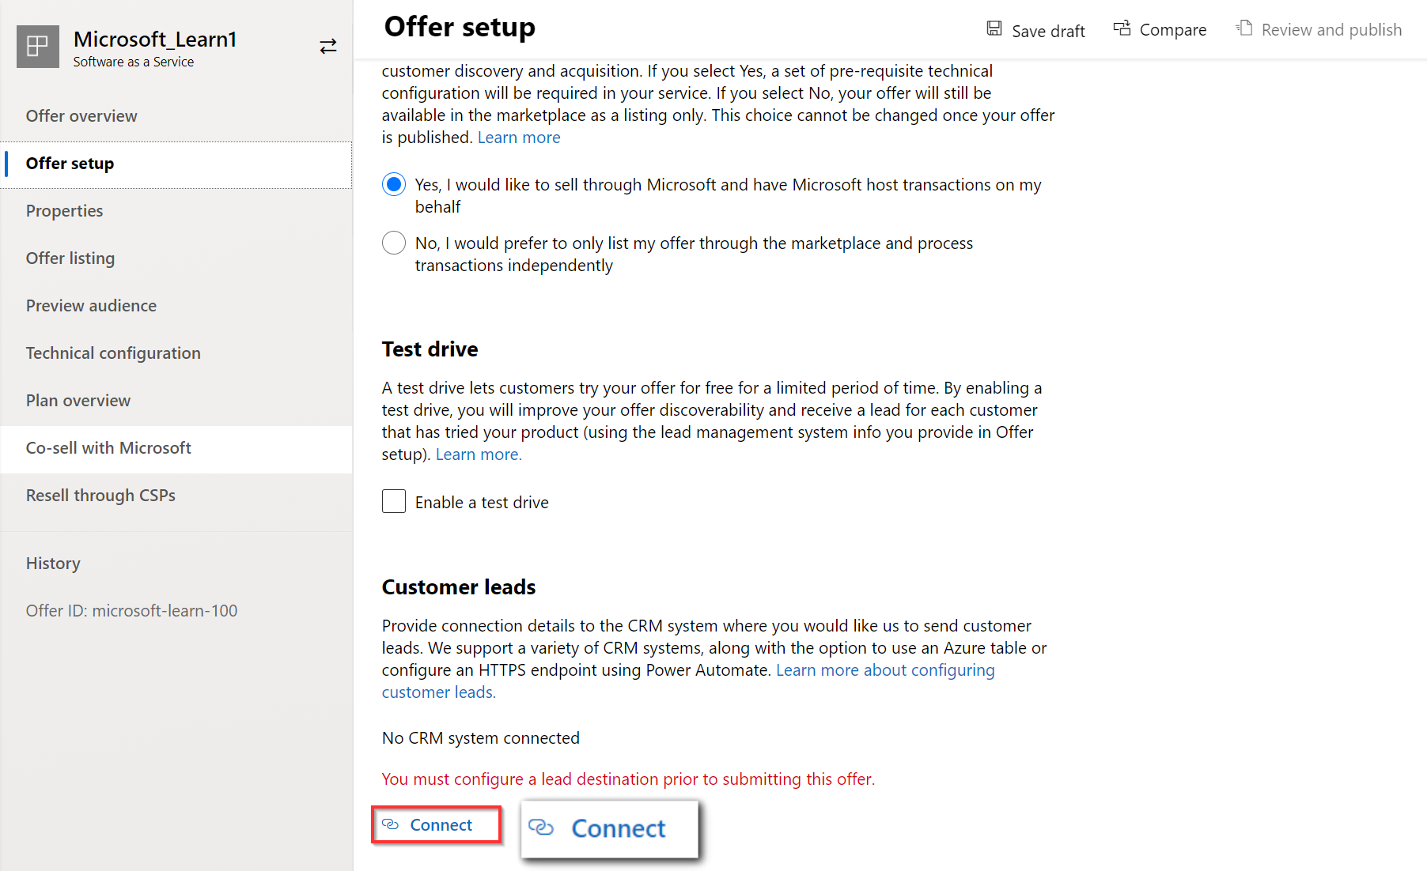
Commercial marketplace lead management
Connecting your Customer Relationship Management (CRM) system to get customer leads from your commercial marketplace offer
Offering a free trial or test drive of your offer so customers can test your solution
Integrating your software with Azure Active Directory for streamlined purchasing, fulfillment, and management of your solution for customers
Building a transact offer to provide streamlined purchases and automated distribution of your solution
Notes:
Commercial marketplace lead management - Training | Microsoft Learn

Slide 13
Procurement Solutions and Marketplace
Access to the Marketplace requires Entra ID integration
Provides SSO for users
Allows users to login through Procurement systems
User governance for access to Marketplace

Slide 14
20 minute break

Slide 15
Labs – Entra ID integration
After these labs, you will know:
Control in Entra ID (Azure AD) who has access to applications.
Enable your users to be automatically signed-in to applications with their Azure AD accounts.
Manage your accounts in one central location - the Azure portal.
Applications for these labs:
SAP Ariba
Service NOW
Coupa
Oracle ERP
*NOTE: These labs can be customized based on the applications that that customer utilizes.
Notes:
Tutorial: Azure Active Directory integration with Ariba - Microsoft Entra | Microsoft Learn
Tutorial: Azure Active Directory single sign-on (SSO) integration with ServiceNow - Microsoft Entra | Microsoft Learn
Tutorial: Azure Active Directory integration with Coupa - Microsoft Entra | Microsoft Learn
Tutorial: Azure AD SSO integration with Oracle Fusion ERP - Microsoft Entra | Microsoft Learn

Slide 16
Private Offers
Engagement with Microsoft partner and their solution
Procuring a private offer is a three (3) step process:
1. Provide billing account ID and contact information to the partner
2. Accept the private offer
3. Purchase the private offer
Requires Entra permission for SSO to Microsoft partner solutions through user consent
Within Applications -> Enterprise applications -> Consent and permissions -> User consent settings
Select the consent setting
Save settings

Slide 17
Walk through of private offers
https://learn.microsoft.com/en-us/marketplace/private-offers-in-azure-marketplace
Notes:
https://learn.microsoft.com/en-us/marketplace/private-offers-in-azure-marketplace

Slide 18
Private Offers customer experience
https://www.youtube.com/watch?v=TANUlgLuVqI

Slide 19
45 minute break

Slide 20
Governance and Procurement management

Slide 21
Governance of Product Inventory
Avoid unrestricted access
1
Have a subset of products
2
Tailor the marketplace for organizational needs
3
Create specific team catalogs at the subscription level
4
Notes:
Procurement playbook - How to drive custom deals on Azure Marketplace - Microsoft marketplace | Microsoft Learn

Slide 22
Private Marketplace
Blocks products from purchase in public marketplace (exceptions: of Microsoft published and endorsed Linux distributions)
Users submit requests to add a product to the allowlist
Marketplace administrator has authority to approve request
Private offers can be automatically enabled, if configured to

Slide 23
Procurement Management
Marketplace Limitations
Role-based access control is within subscription
Anyone with subscription owner/contributor permissions can purchase
No "out of the box" integration with enterprise procurement or workflow
Organization must adhere to procurement policies and procedures
Must be managed externally to the Azure portal
Examples: Identifying who authorizes purchases
Established approval hierarchies
Determination of who executes purchase

Slide 24
Private Marketplace Workflow
Private Marketplace offers some control over individual purchase
Enables products as "on-demand"
Procedural approvals allow products to be made available by marketplace administrator
After purchase, product is removed and unavailable until next request is made
Notes:
Procurement playbook - How to drive custom deals on Azure Marketplace - Microsoft marketplace | Microsoft Learn

Slide 25
Private Marketplace lab
Lab exercise
Must be Global Administrator to complete
Notes:
Create and manage Private Azure Marketplace collections in the Azure portal - Microsoft marketplace | Microsoft Learn

Slide 26
Summary
What you learned:
Explain how to enable SSO to Marketplace with Procurement Systems.
Understand the ways to enable of Entra ID authentication and authorization to Procurement Systems.
How to Set up a private Marketplace.
How to create purchasing permissions and resource limits.

